Slide 1

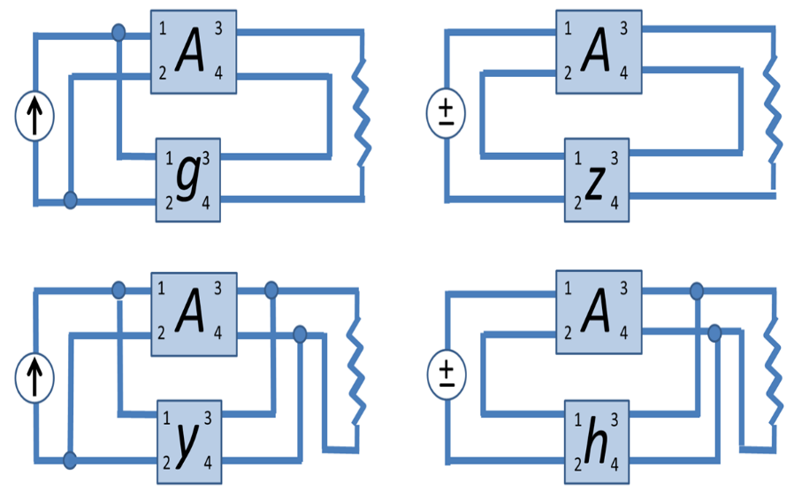
Shri Ramdeobaba College Of Engineering and Management ,Nagpur
Department of
Electronics and Communication Engineering
Academic Session 2023-2024
Presentation On The Topic – Feedback topologies
Course Name – Comprehensive Viva
Presented by:-
Name:-Ganesh Narayan Moroliya
Section:- A
Batch :- A2
Roll No:-102

Slide 2
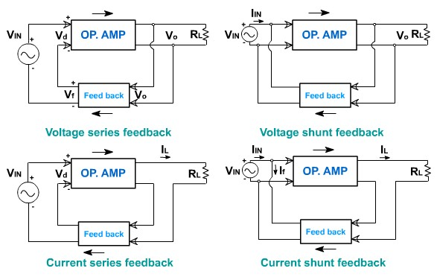
Contents
Feedback Amplifier
Types of Feedback Amplifiers
Feedback Amplifier Topologies
Current series feedback amplifier
Voltage series feedback amplifier
Current shunt feedback amplifier
Voltage shunt feedback amplifier
Difference between Feedback Topologies
Advantages ,Disadvantages and Applications of Feedback Amplifier

Slide 3
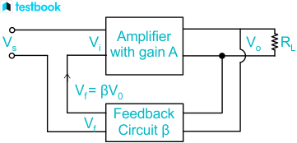
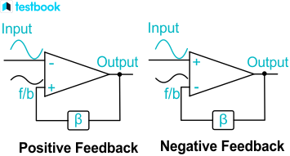
Feedback Amplifier
Feedback amplifier is a type of amplifier whose feedback exists between the output and input signal. The concept of feeding the output signal back to its input circuit is known as feedback and that is why it is known as a feedback amplifier. It is dependent between the output and input with effective control.
Feedback amplifiers are divided into two types: positive feedback and negative feedback.

Slide 4
Types of Feedback Amplifiers
Positive Feedback Amplifiers
In this feedback amplifier, the input voltage or the current is in phase with the input signal.
Both the input signal and feedback introduce a phase shift of 180° and makes a 360° resultant phase shift to be in phase with the input signal.
It increases the gain of the amplifier but also increases distortion and instability.
2.Negative Feedback Amplifier
In this feedback, the input voltage or current is out of phase with the input signal, opposing it.
In this type of circuit, a 180° phase shift is introduced, but the resultant phase shift is zero. Hence the feedback voltage would be 180° out of phase with respect to the input signal.
It reduces the amplifier’s overall gain but also reduces distortion and overall noise.

Slide 5
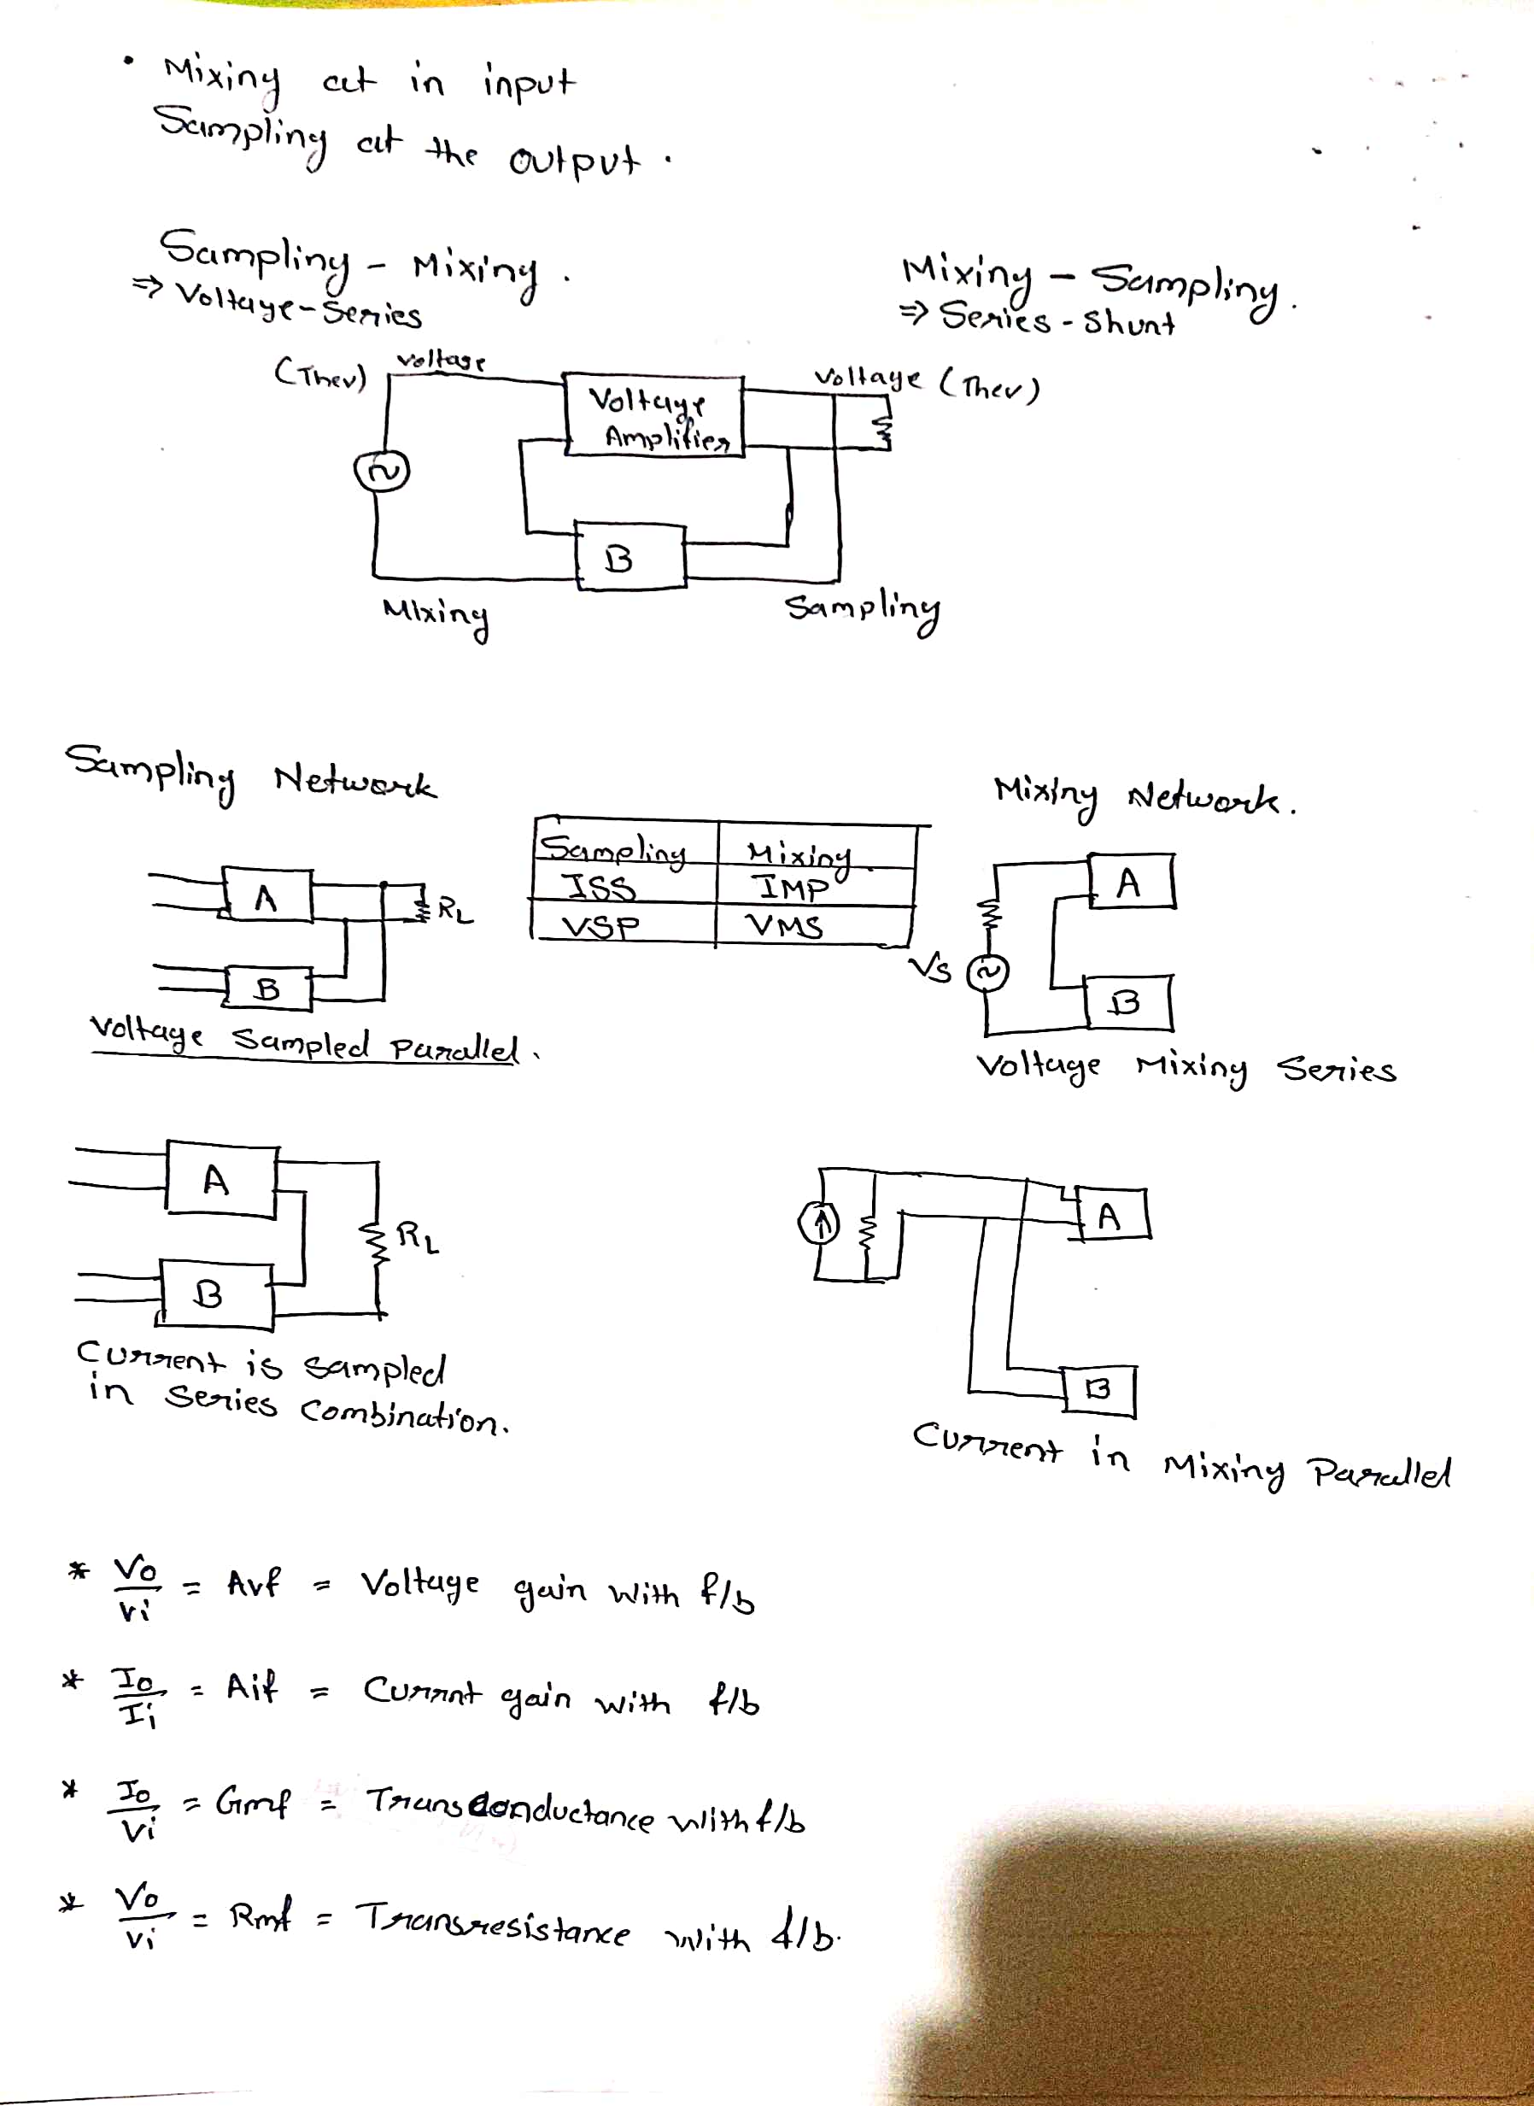
Feedback Amplifier Topologies
.
There are four types of feedback topology
Current series feedback amplifier
Voltage series feedback amplifier
Current shunt feedback amplifier
Voltage shunt feedback amplifier
Mixing network at input
Sampling network at output

Slide 6
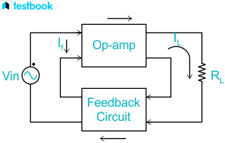
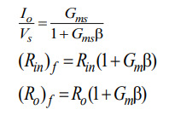
Current series feedback amplifier
Thevenin’s
Norton’s
In this feedback amplifier, both the input and output impedance are increased.
The feedback circuit is placed in series with the input and output.
Here a fraction of the output voltage is applied in series with the input voltage in the feedback circuit.
Io/Vi=Gmf (Trans Conductance with f/b)
Mixing
Sampling
S-M (Current-Series)
M-S(Series-Series)

Slide 7
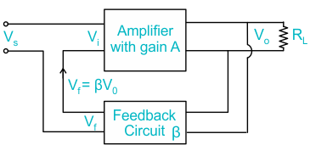
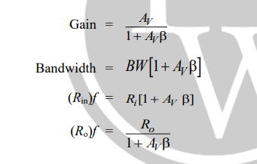
Voltage series feedback amplifier
Thevenin’s
Thevenin’s
The feedback circuit is connected in shunt with the output in such a way that it decreases the output impedance and increases the input impedance.
In this circuit, it is placed in a shunt with the output but in series with respect to the input signal.
Vo/Vi=Avf (Voltage gain With f/b)
Mixing
Sampling
S-M (Voltage-Series)
M-S(Series-Shunt)

Slide 8
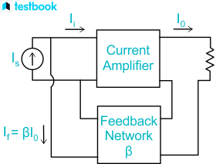
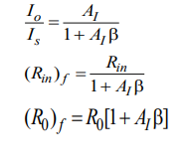
Current shunt feedback amplifier
Norton’s
Norton’s
It increases the output impedance and because of connecting the feedback circuit in parallel with the input, the input impedance is decreased.
Here, the feedback circuit is placed in series with the output and in parallel with the input.
Io/Is=Aif (Current gain with f/b)
Mixing
Sampling
S-M (Current-Shunt)
M-S(Shunt-Series)

Slide 9
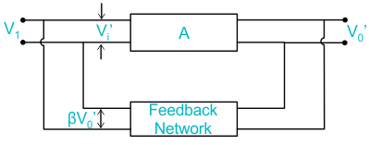
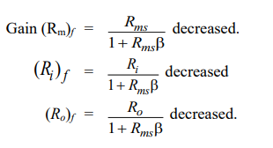
Voltage shunt feedback amplifier
Norton’s
Thevenin’s
Here the feedback circuit is placed in a shunt with respect to output and input as well.
It decreases the input and output impedance.
Vo/Is=Rmf (Trans resistance with f/b)
Mixing
Sampling
S-M (Voltage-Shunt)
M-S(Shunt-Shunt)

Slide 10
Difference between Feedback Topologies
characteristics | Voltage series | Voltage Shunt | Current Series | Current Shunt
Voltage Gain | Decreases | Decreases | Decreases | Decreases
Bandwidth | Increases | Increases | Increases | Increases
Noise | Decreases | Decreases | Decreases | Decreases
Input Resistance | Increases | Decreases | Increases | Decreases
Output Resistance | Decreases | Decreases | Increases | Increases

Slide 11
Advantages and Disadvantages of Feedback Amplifier
Advantages
Disadvantages
Improves stability gain of the circuit by negative feedback amplifiers.
Input resistance can be increased by selective configurations.
Similarly, output resistance can be decreased.
Reduces noise and distortion by negative feedback.
Increased noise and distortion in positive feedback.
Has an increased output gain for current series and current shunt feedback amplifiers.
Application of Feedback Amplifier
They can be used in regulated power supplies.
They are generally used in amplifiers where large bandwidth is required.
Generally used in electronic amplifiers.

Slide 12
Thank You

